Slide 1
PROJECT TITLE SECURE DATA HIDING IN IMAGE USING STEGANOGRAPHY
SECURE THE DATA TO PREVENT HACKERS
Presented By: JAYDEV SAHU
Student Name : JAYDEV SAHU
College Name & Department : ASBM UNIVERSITY, BCA

Slide 2
OUTLINE
Problem Statement
Technology used
Wow factor
End users
Result
Conclusion
Git-hub Link
Future scope

Slide 3
Problem Statement
Traditional text encryption methods often require complex algorithms and external storage, making them less intuitive for non-technical users. This project embeds a secret message directly into an image by manipulating pixel values, ensuring secure and hidden communication. The encoded message can only be retrieved with the correct passcode, adding an extra layer of security. This approach provides a simple yet effective method for image-based encryption and decryption.

Slide 4
Technology used
Programming Language: Python, Platforms : IDLE(PYTHON) Libraries:
OpenCV (cv2) – For image processing
OS (os) – For interacting with the operating system

Slide 5
Wow factors
Passcode-Protected Decryption: Ensures only authorized users can retrieve the hidden message, adding an extra security layer.
Image-Based Encryption: Unlike traditional text encryption, this project hides messages within image pixels, making detection difficult.

Slide 6
End users
End Users:
Individuals – Users who want to securely hide personal messages in images.
Cybersecurity Enthusiasts – Learners and researchers exploring steganography techniques.
Journalists & Activists – People needing covert communication to protect sensitive information.
Developers & Researchers – Those interested in integrating image-based encryption into security applications.

Slide 7
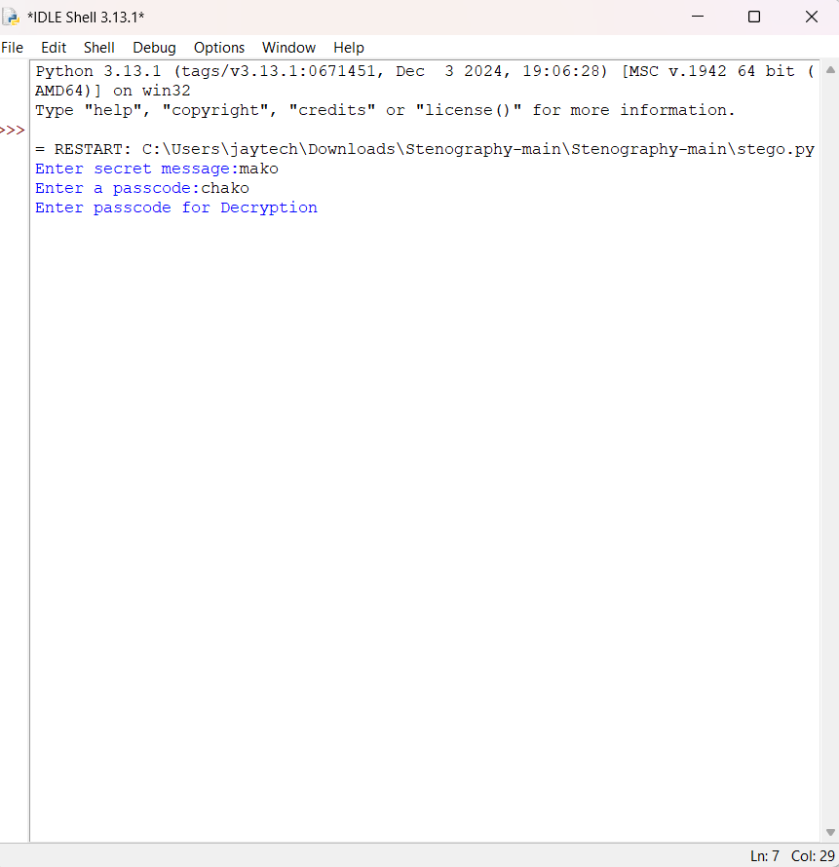
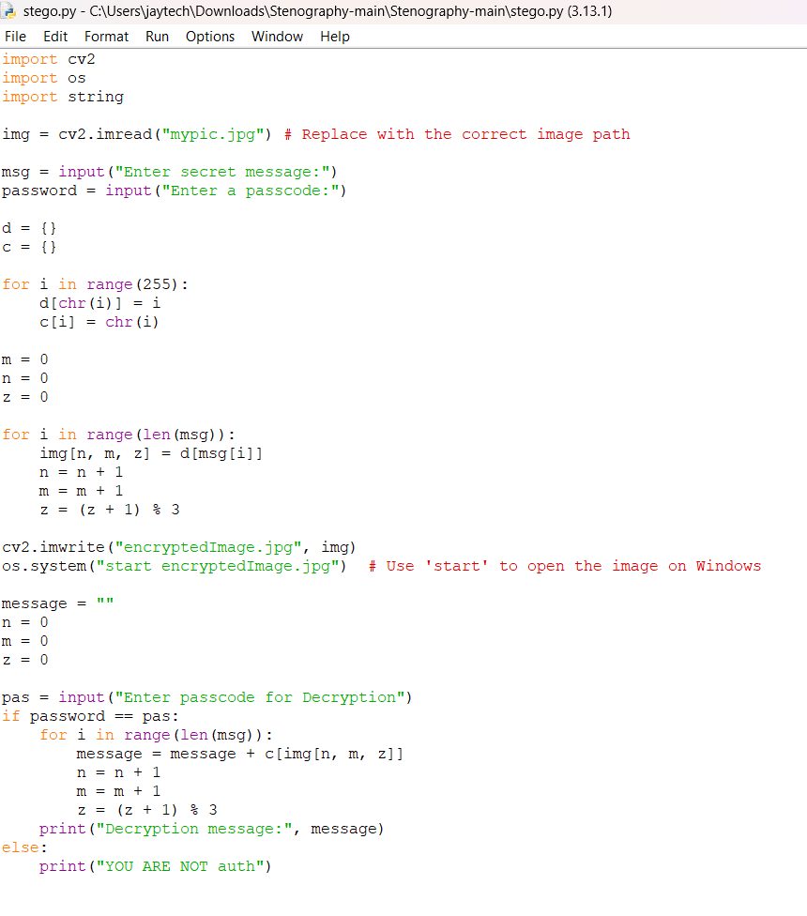
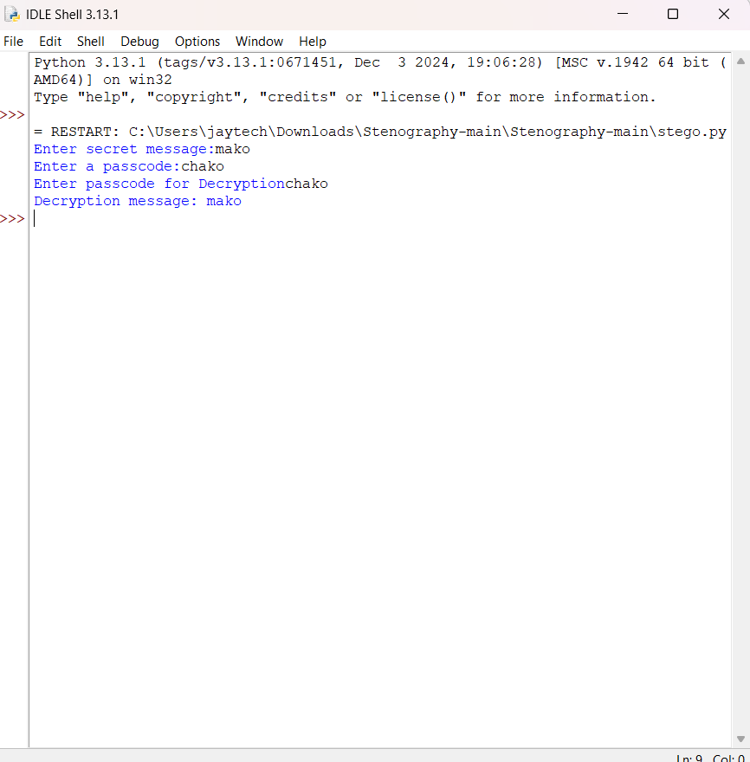
Results
Screenshots of the outcome (min 3)

Slide 8
Conclusion
Conclusion:
This project provides a simple yet effective approach to steganography by embedding secret messages within image pixels. The integration of a passcode ensures an additional layer of security, making it useful for secure communication. Its lightweight implementation using Python and OpenCV makes it accessible for learners, developers, and security enthusiasts. Overall, it demonstrates a practical application of image-based encryption for enhancing data privacy.

Slide 9
GitHub Link
https://github.com/jaydev-jay/stego-project.git

Slide 10
Future scope(optional)
Enhance security by integrating stronger encryption techniques like AES before embedding the message.

Slide 11
THANK YOU

